Slide 1
CIS 4296: Lecture3
CD1
Requirements Gathering
Statement of Work
Temple terminology/definitions

Slide 2
Outline
Systems Analysis Activities
What Are Requirements?
Models and Modeling
Stakeholders
Information-Gathering Techniques
Creating a “Statement of Work”

Slide 3
What are we really doing?
Business Analysis
Systems Analysis
Requirements Gathering
Requirements Eliciting
Discovering Requirements
It’s really all of these!

Slide 4
Many requirements are hidden
Elicit or gather information about the requirements
This will form the basis of the requirements
Discovery
Integrated interactive data elicitation and analysis
Understand the project’s real challenge, the value of addressing it adequately, it causes and the business requirements that will provide value by achieving objectives

Slide 5
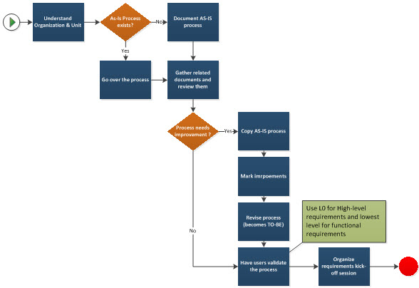
Approach for business process analysis

Slide 6
Requirements Gathering/Analysis Activities
Gather Detailed Information
Interviews, questionnaires, surveys, artifacts, observing business processes, researching vendors, comments and suggestions
Define Requirements
Modeling functional requirements and non-functional requirements
We will use activity diagrams to model the business requirements
Prioritize Requirements (this will come later)
Essential, important, vs. nice to have
Evaluate Requirements with Users
User involvement, feedback, adapt to changes

Slide 7
What Are Requirements?
Business Requirements
System Requirements
Functional requirements
Non-functional requirements
Functional Requirements– the activities the system must perform
Business uses, functions the users carry out
Non-Functional Requirements– other system characteristics
Constraints and performance goals

Slide 8
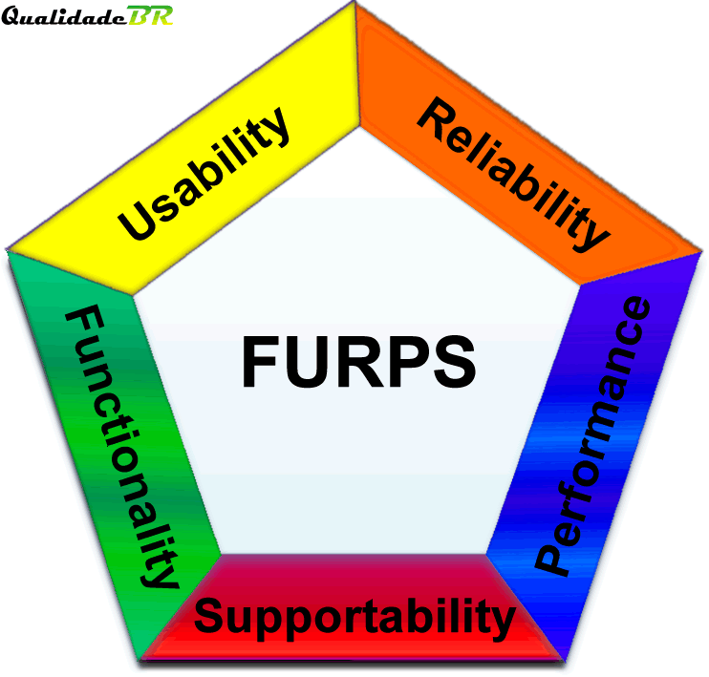
FURPS+ Requirements Acronym
Functional requirements
Usability requirements
Reliability requirements
Performance requirements
Security or Supportability
requirements
+ even more categories…

Slide 9
FURPS+ Requirements Acronym

Slide 10
Requirements
Explicit
Specific need
Implicit
Complaint or frustration that implies need for requirement
Differentiate between
requirements
needs
concerns
wants
comments
frustrations
suggestions

Slide 11
Stakeholders Who do you involve and talk to?
Stakeholders– persons who have an interest in the successful implementation of the system
Internal Stakeholders– persons within the organization
External stakeholders – persons outside the organization
Operational stakeholders – persons who regularly interact with the system
Executive stakeholders– persons who don’t directly interact, but use the information or have financial interest
Who are the stakeholders for the URP Approval System?
Should you interview any of them?

Slide 12
Information Gathering Techniques
Interviewing users and other stakeholders
Surveys (online tools)
Reviewing inputs, outputs, and documentation – artifacts
Observing and documenting business procedures
Researching vendor solutions
Collecting active user comments and suggestions

Slide 13
Themes for Information Gathering Questions
NOTE that there are no questions related to technology
at this point – the focus is on business process

Slide 14
Interviewing – Questioning Techniques
Prepare – learn as much as you can about their business
Open ended questions – allow the interviewee to set the direction, telling you what they think is important
Clarify, don’t assume, Follow-up – Probe Further!
Be Flexible! You can’t just follow a script (or your prepared questions)
Ask WHY
Listen, analyze, repeat your understanding
Ask in a different way
Welcome unexpected answers

Slide 15
The importance of understanding
Requirement: "Limit schedule appointments to 50% of available hours".
Programmers: Interpreted the 50% limit as 50% of all time slots for the entire day
Client: The system is still allowing us to book more than 50% of the available slots. For example, on Jan 27th I have 5 tutors working at 11am. I should only be able to schedule 2 appointments for that time slot, but I was able to schedule 5. That leaves us with no tutors to take walk-in sessions.

Slide 16
Additional Techniques
Observe and Document Business Processes
Watch and learn
Document with Activity diagram (next section)
Research Vendor Solutions
See what others have done for similar situations
White papers, vendor literature, competitors
Collect Active User Comments and Suggestions
Feedback on models and tests
Users know it when they see it

Slide 17


Slide 18
ARTIFACTS: Review Inputs, Outputs, and Procedures

Slide 19
A bit more on requirements
Start with the goals they want to achieve
WHAT not HOW
Understand the current system (even if it is paper-based)
The Good
The Bad
And
The Ugly

Slide 20
Keeping an Open Items List

Slide 21
Data Analysis
It’s not just about developing systems to put the data in….
You need to give your clients a way to analyze the data
We do not develop reports in capstone
Instead, we give:
Flexible search options
Download capabilities so they can manipulate in Excel
Create PDFs if needed (forms)
Do not commit to reports or reporting systems; use phrases like ‘ability to analyze data’

Slide 22
Temple Terminology Specifics
TUID versus Access Net ID
TUID is a 9 digit number beginning with 9
Access Net ID is a login id
Both are unique identifiers
Not all Access Net IDs begin with tux99999-ex: mcginnr
Banner and Cognos
Banner is our ERP, used to track student, course, financial and other information

Slide 23
Including “time” in your systems
“Term”
Most of your systems will have to account for time, generally in the format of terms
Universities run on a term schedule
Term format:
YYYYMM
201433 – Fall semester, 2014
201503 – Spring semester, 2015
Example: CRNs are reused across semesters. They are only unique within a ‘term’
Also need to maintain historical data
Multiple terms are active at all times – planning for spring while in Fall – Finishing Summer grading during Fall - not a hard start and stop
The design of your systems (screens, DB, etc.) need to account for time

Slide 24

Under Commit
Over Deliver!!!

Slide 25
